Slide 1
Power System Fault Detection and Classification
CAPSTONE PROJECT
Presented By:
Punit Verma-Guru Jambheshwar University of Science and Technology-Computer Science and Engineering

Slide 2
OUTLINE
Problem Statement
Proposed System/Solution
System Development Approach
Algorithm & Deployment
Result (Output Image)
Conclusion
Future Scope
References

Slide 3
Problem Statement
The goal is to design a machine learning model that can identify and classify different types of faults in a power distribution network using voltage and current phasor data. By distinguishing between normal operations and faults such as line-to-ground, line-to-line, and three-phase, the model will support faster fault detection and improve the overall stability and reliability of the power grid.
GitHub Link :- https://github.com/PunitVerma0009/IBM-Cloud-Project

Slide 4
Proposed Solution
The proposed system addresses the challenge of detecting and classifying faults in a power distribution system using machine learning techniques. The solution leverages electrical measurement data to accurately identify fault types and support rapid grid response. The following components make up the solution:
Data Collection:
Used a publicly available dataset from Kaggle consisting of voltage and current phasor readings under various conditions.
Focused on identifying different fault types such as line-to-ground, line-to-line, and three-phase faults.
Data Preprocessing:
Removed the 'Fault ID' column to avoid data leakage during training.
Cleaned the dataset by standardizing features to prepare for model training.
Machine Learning Algorithm:
Implemented a Snap Logistic Regression model to classify the system state as normal or one of several fault types.
The model was trained using 506 rows of cleaned data.
Deployment:
Developed and deployed the model entirely on IBM Cloud for accessible and scalable use.
Ensured the system supports cloud-based testing and future integration with real-time data sources.
Evaluation:
The model achieved an accuracy of 41%, limited by the small dataset size.
Performance can be improved with a larger and more balanced dataset.

Slide 5
System Approach
The "System Approach" section outlines the strategy and resources used to design and implement the fault detection model in a power distribution system. The system leverages cloud-based resources and essential Python libraries to build, train, and evaluate the model.
System Requirements:
IBM Cloud environment with 8 CPUs and 32 GB RAM for training and deployment.
High-performance computing resources were essential due to the data preprocessing and model training phases.
Libraries Required to Build the Model:
Pandas – for data loading, cleaning, and manipulation.
NumPy – for numerical operations.
Scikit-learn – for implementing Snap Logistic Regression and evaluation metrics.
Matplotlib / Seaborn – for visualizing fault distributions and model performance.
Joblib / Pickle – for saving and deploying the trained model.

Slide 6
Algorithm & Deployment
In this section, we describe the machine learning algorithm used to detect and classify faults in the power distribution system.
Algorithm Selection:
Snap Logistic Regression was chosen due to its simplicity, interpretability, and ability to handle binary and multiclass classification. It is suitable for small datasets and performs well in identifying relationships between electrical measurements and fault types.
Data Input:
The model uses features derived from voltage and current phasors under different system conditions.
The target variable indicates whether the system is operating normally or experiencing a specific type of fault (e.g., line-to-ground, line-to-line, three-phase).
Training Process:
The dataset was cleaned and preprocessed, including removal of the Fault ID column to avoid label leakage.
The model was trained on 506 rows of data, using IBM Cloud resources (8 CPUs, 32 GB RAM).
Given the limited data, the model was trained using default parameters without hyperparameter tuning to avoid overfitting.
Prediction Process:
Once trained, the model takes new phasor readings as input and classifies them into one of the fault categories or normal operation.
The model is deployed on IBM Cloud and can be integrated into a real-time system for live fault monitoring and prediction.

Slide 7
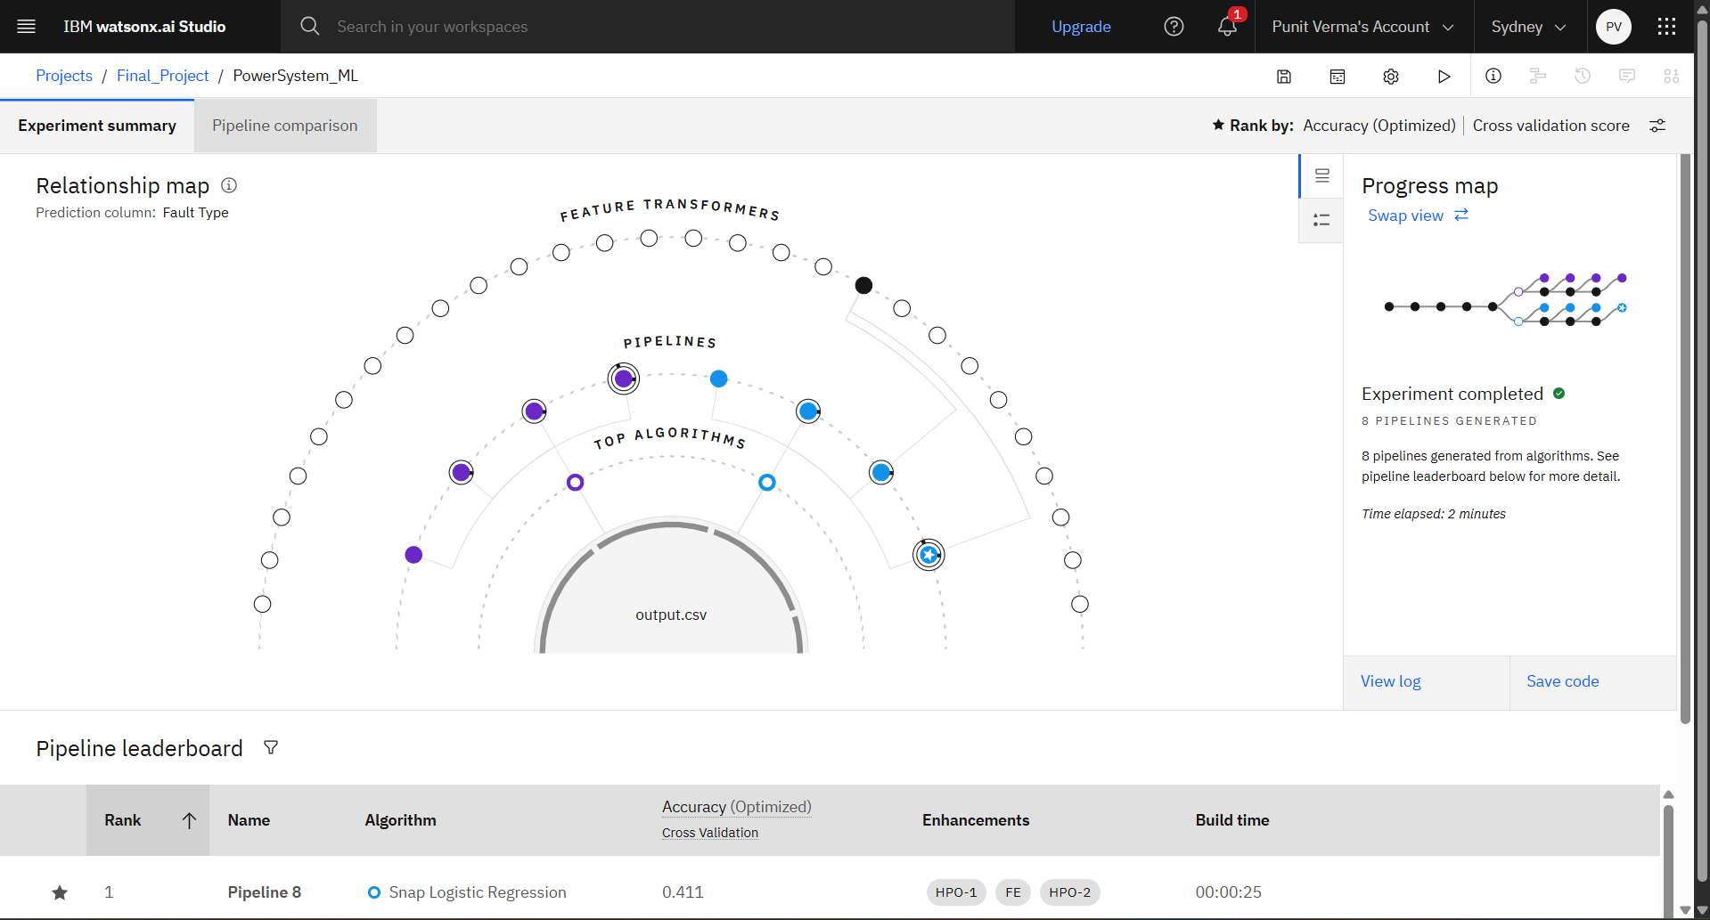
Result

Slide 8
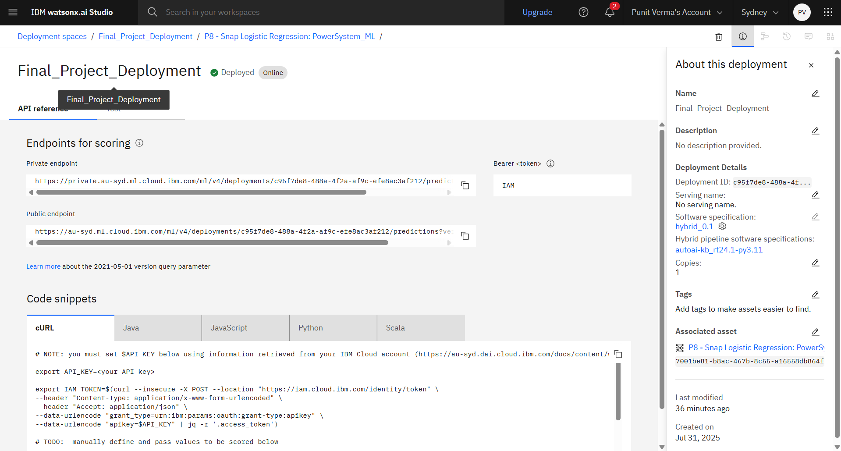
Result

Slide 9
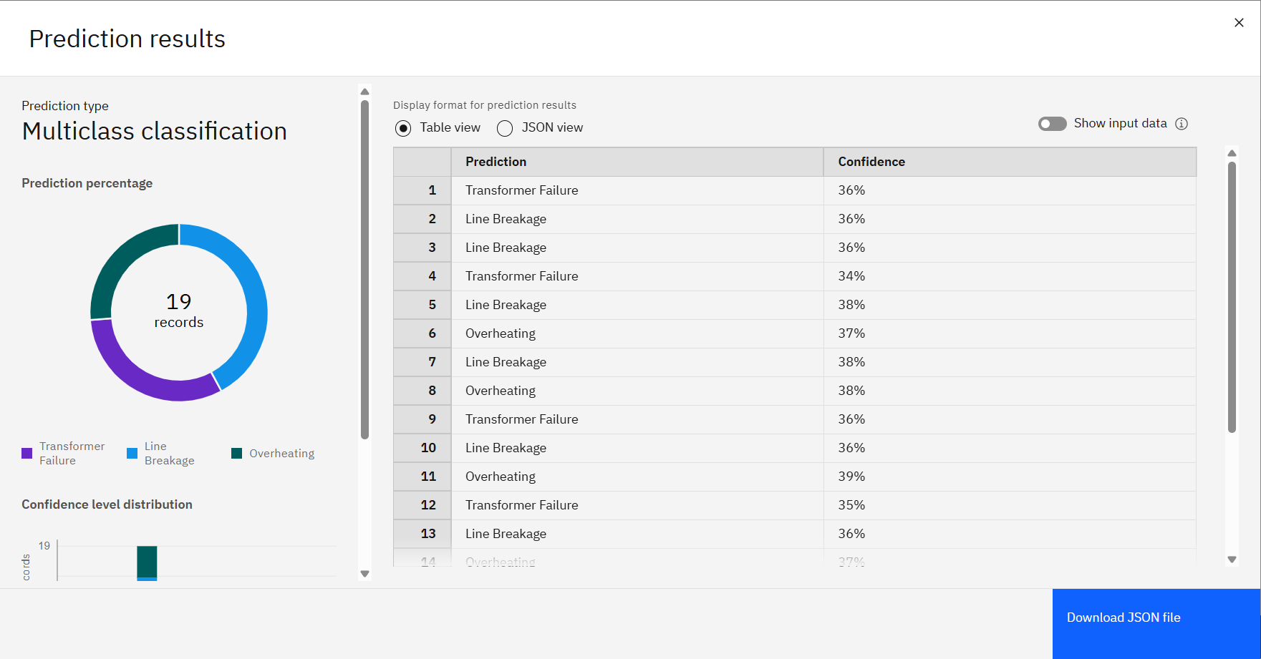
Result

Slide 10
Conclusion
The proposed machine learning-based solution successfully demonstrates the ability to detect and classify faults in a power distribution system using electrical measurement data. By employing Snap Logistic Regression, the model was able to classify various fault types based on voltage and current phasor inputs. The entire model was developed and deployed on IBM Cloud, leveraging a computing environment with 8 CPUs and 32 GB RAM.
Effectiveness of the Solution:
The model achieved an accuracy of 41%, which reflects moderate performance due to the limited dataset size (only 506 records).
It provides a proof of concept that fault classification can be automated using machine learning with appropriate data and system setup.
Challenges Encountered:
Insufficient data volume made it difficult for the model to generalize well across fault types.
Lack of feature variety or real-time input sources may have limited the learning potential of the algorithm.
Removing the Fault ID to avoid leakage also reduced the number of directly interpretable labels.
Importance of Accurate Predictions:
Accurate fault detection is essential for minimizing downtime, preventing equipment damage, and ensuring power grid reliability. Even a small improvement in fault classification accuracy can lead to faster response times and improved operational efficiency in real-world power systems.

Slide 11
Future scope
Potential Improvements:
Increasing dataset size with more real-time fault scenarios would significantly enhance prediction accuracy.
Exploring advanced models like Random Forest, SVM, or Neural Networks could yield better performance.
Incorporating additional features such as phase angles, frequency deviations, and time-based indicators could improve model sensitivity.

Slide 12
References
Kaggle Dataset "Power System Fault Detection Dataset." Retrieved from: https://www.kaggle.com/ (Used as the main dataset for training and evaluating the model.)
IBM Cloud Platform Practical training received during internship on building and deploying machine learning models using IBM Cloud’s AutoAI and cloud-based services. (Used for model creation, resource allocation, and deployment.)

Slide 13
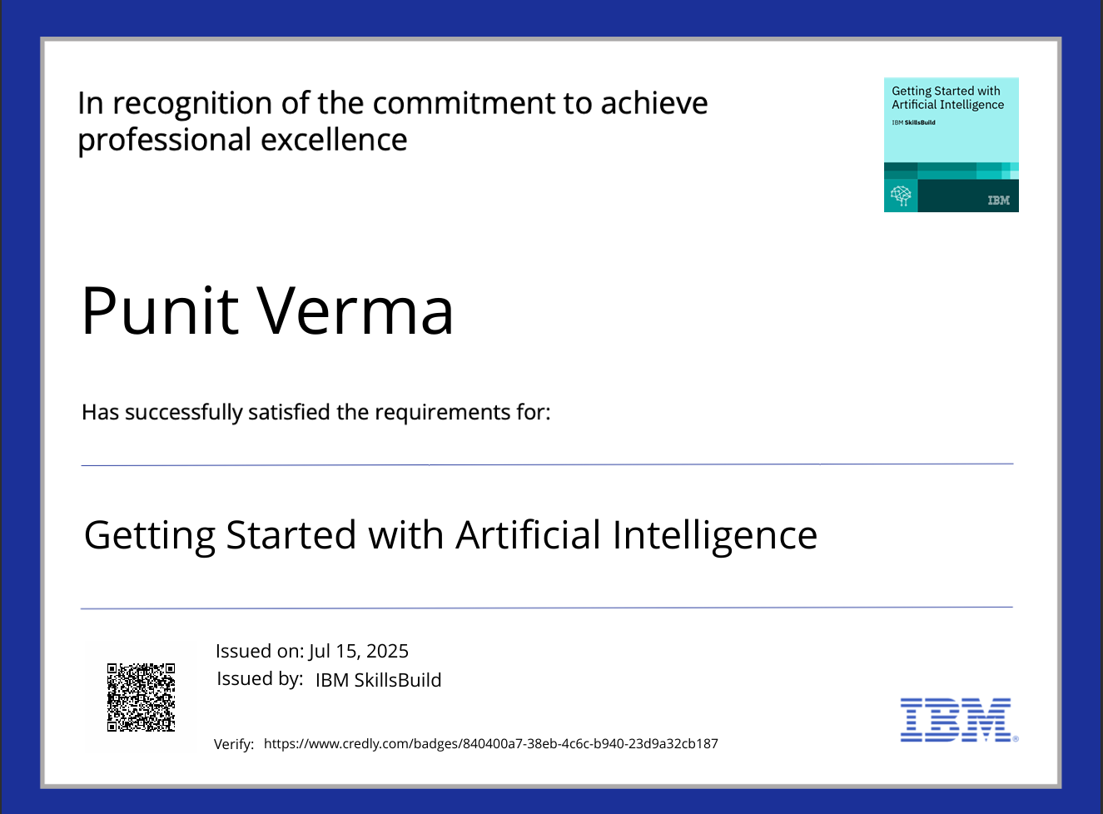
IBM Certifications

Slide 14

IBM Certifications

Slide 15

IBM Certifications

Slide 16
THANK YOU GitHub Link :- https://github.com/PunitVerma0009/IBM-Cloud-Project

